Slide 1
CODE COMPANION
* See slide notes for page directions
Notes:
When listing all project collaborators, either use commas or bullets

Slide 2
PROBLEM STATEMENT
Computer Science engineering students at LPU face difficulty accessing organized, updated lab experiments and viva resources, as online materials are often outdated or scattered. Even though experiments change each semester, they remain tied to core syllabus topics, highlighting the need for a topic-based system that links syllabus units to all relevant, up-to-date experiments and viva content.

Slide 3
CODE COMPANION
RESEARCH GOAL
Research Objectives
Research Hypothesis
To understand how Computer Science students at LPU access lab experiments and viva materials, identify the challenges they face with changing semester content, and explore ways to deliver organized, topic-linked, and up-to-date resources through a centralized web platform.
1.Identify how students currently access lab and viva resources
2.Discover the pain points caused by outdated or unorganized resources
3. Understand the students’ expectations from a lab resource platform
If lab experiments and viva questions are organized according to syllabus topics on a centralized platform, then Computer Science students at LPU will find it easier to access updated and relevant academic content — saving time, reducing confusion, and improving exam readiness.
Notes:
Think about the questions listed above and answer them.
Can you think of anything else in regards to economy and trade that you would like to add?

Slide 4
PRIMARY RESEARCH
1
2
3
[Sample Size]
[Target Audience]
[Method]
30 Participants
10 From Each Year
*Computer Science Engineering students at LPU
*Especially those in 2nd to final year
Online Surveys
IN-PERSON INTERVIEWS
4
[Sampling Technique]
Stratified Purposive Sampling
*Stratified – Because you're dividing students into relevant groups (strata):.
*Purposive – Because you're intentionally selecting participants who a
Notes:
What are the rules and laws of your colony? Think about what helps the colonists stay safe and maintain a healthy, happy colony.
In each shape…
Name the rule/law
Describe why it’s important for the colony/colonists
Explain the consequences for not following this rule/law
To add more shapes, click on the last shape, then on SmartArt Tools -> Design -> Add Shape After

Slide 5



Interview Questionnaire
Need-Based Questions
Task-Based Questions
Value-Based Questions
What difficulties do you face when looking for lab experiments or viva questions?
Do you often find outdated or irrelevant resources online?
Can you walk me through how you usually prepare for lab exams or submissions?
How do you decide whether a resource is correct or useful?
How important is it for you to get verified or trusted lab resources?
Would you find it helpful if lab experiments were grouped by syllabus topics or units?
Notes:
Use the SmartArt to determine the flow of government/leadership:
Who leads the colony (executive)? What is that person/are those people’s duties?
Who makes the rules (legislature)?
Who ensures the rules are followed (judicial)?
Are there any other branches of government? If so, who are they and what is their job?
To add more shapes, click on the left shape first, then on SmartArt Tools -> Design -> Add Shape After
Do the same for the shape to the right
Feel free to rename the branches!

Slide 6
Competitive Analysis
App/Platform Name | Target Audience | Features | USP | Pricing
Google Drive / WhatsApp groups | CSE students, informal sharing networks | Manual file sharing, folders with PDFs and codes | Free and fast, but unorganized and not verified | Free
YouTube / Blogs | Students seeking code and viva walkthroughs | Video explanations, tutorials, comments | Rich content, but often not topic-aligned or syllabus-mapped | Free / Ad-supported
PMS | CSE students (2nd to 4th year), exam-focused learners | Topic-wise experiment view, viva Qs, uploads, bookmarks, verified content | Topic-aligned, updated, centralized, with personalization & filtering | Free or university-supported
Notes:
*OPTIONAL SLIDE* If you are interested in learning more about social groups, look up the caste or class system.

Slide 7

Persona-1
Name: Nikith Age:20 Occupation:3rd year student Location: LPU hostel Branch: CSE | Personality *Curious and hardworking *Struggles under pressure *Prefers structures systems and verified sources | Goals *Prepare well for the lab and viva *Reduce confusion with changing lab formats *Avoid wasting time
Nikith is a 3rd-year CSE student at LPU who struggles to find reliable lab materials during exams. He’s frustrated by outdated PDFs and scattered resources across Drive and WhatsApp. He wants a centralized, topic-wise platform for accurate experiments and viva questions.
*Pain Points Finds lab manuals inconsistent with updated experiments *Can’t find viva questions in one place | Needs *A topic-wise list of experiments matching his syllabus *verified content or peer-reviewed files | Tech expertise Medium- Uses Google Drive, college LMS, basic coding tools, and simulators
I just want to study what’s needed, without having to dig through 10 different folders and ask 5 people for links.
Notes:
What is the name of your colony song?
Write lyrics to the song and, if you are feeling creative, use a computer program or instruments to create the music that goes along with it!
To insert an audio file, click on Recording -> Audio -> Audio on My PC and choose your file

Slide 8

Persona-2
Name: Rahul Varma Age: 21 Occupation: 2nd year student Location: Off-campus apartment, LPU Branch: CSE | Personality Avoids relying on WhatsApp or group links Likes interactive and mobile-friendly content Struggles to stay organized during exam time | Goals Understand lab experiments through visuals Avoid last-minute confusion during viva Access structured, updated lab content anytime
Rahul is a 2nd-year CS student at LPU who prefers to study independently from his off-campus apartment. While he's tech-savvy and curious, he often gets confused when lab topics shift mid-semester. Group chats are overwhelming, and finding specific experiments is a struggle. He wishes for an organized, visual-first app that lets him browse topic-wise lab experiments and viva questions without distractions.
Pain Points Can’t find matching resources when labs change Too many random links and outdated files Visual clarity missing in current lab notes | Needs Visuals (like flowcharts/diagrams) for each experiment Topic filters matching syllabus | Tech Expertise High – Regular mobile app user, uses YouTube, GitHub, Notion, and simulation tools for learning
I don’t want to waste time hunting for experiments — I just need clear, topic-wise labs that help me understand and prepare better

Slide 9
Empathy Map
SAYS I can’t find the correct lab experiment anywhere This PDF isn’t even updated to this semester’s format Why isn’t everything arranged topic-wise? | THINKS What if I miss out on an important viva question? Will this experiment match the current syllabus? I wish there was one clean platform for everything.
FEELS Overwhelmed while preparing for lab exams Frustrated switching between links and folders Relieved when she finds verified or accurate material | DOES Asks classmates for last-minute resources Scrolls through WhatsApp and Drive folders Tries to match lab work with syllabus topics manually Bookmarks helpful resources if she finds any

Slide 10
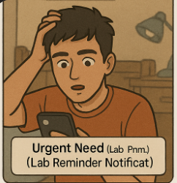
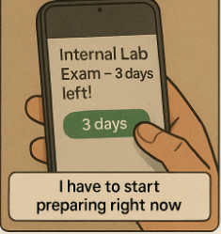
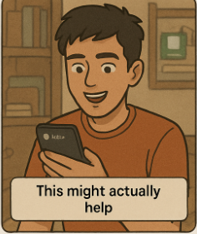
Story board
Coloy Bird
Notes:
Have fun with this slide! Use drawing paper or inking to create your colony’s flag, flower, bird, tree, and its most famous person!
If you use drawing paper, take a photo and insert the image
If you choose to use digital inking, click on the Draw tab and ink away!

Slide 11
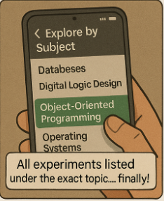
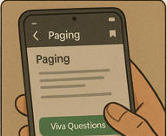

Sharing about the app with others

Slide 12
Stage | Awareness | Consideration | Usage / Engagement | Resolution | Post-Use
User Actions | - Hears about app from peers - Sees it on college forums / posters | - Installs the app - Browses subjects or experiments | - Selects a subject/topic - Views experiments - Saves important viva Qs | - Gets experiment-related doubts cleared - Uploads helpful notes | - Shares app with friends - Gives feedback - Reuses during next semester
Emotions | 🤔 Curious, hopeful | 😐 Cautiously optimistic | 😊 Relieved, satisfied | 😃 Empowered, productive | 😄 Trust, satisfaction
Touchpoints | Posters, Word of mouth, Social media | App UI, Ratings/feedback section | Lab topic tiles, Bookmark icon, Viva toggle | Upload/Rate section, Ask/doubt section | Feedback screen, Reward for sharing
Pain Points | Doesn’t trust student-made apps Thinks it’s the same as WhatsApp drives | UI might be messy Can’t find their year easily | No tags or filters for topics Misses recently visited topics | Confused about how to contribute/upload | No recognition for helpful users No habit-forming loop
Opportunities | Campus testimonials Highlight faculty collaboration | Smooth onboarding with tutorial Personalize dashboard by semester & branch | Add “Related Topics” & “Recently Viewed” Viva filter | Gamify contribution (badges/points) Add AI assistant for Q&A | Create streak rewards Refer & earn access to premium features
CUSTOMER JOURNEY MAPPING

Slide 13
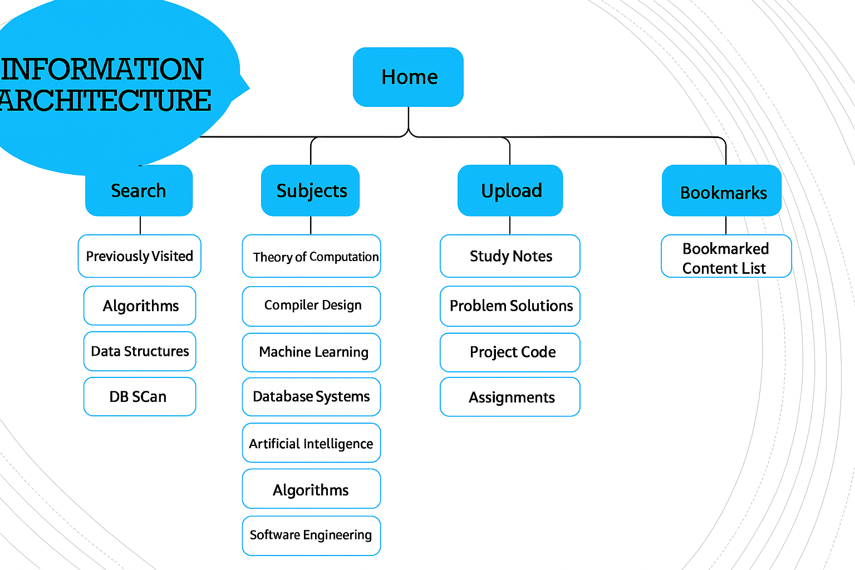
INFORMATION ARCHITECTURE

Slide 14
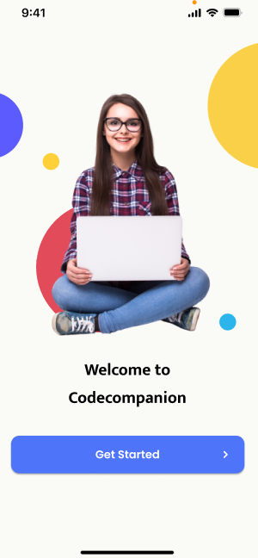
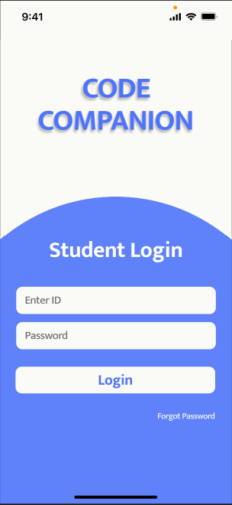
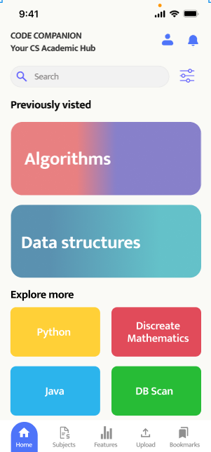
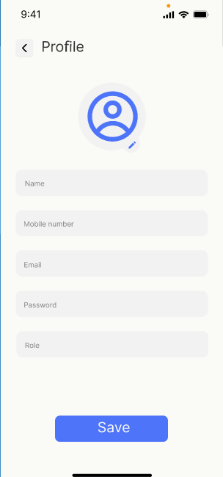
APP PROTOTYPE

Slide 15
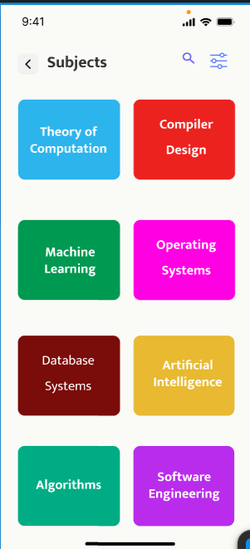
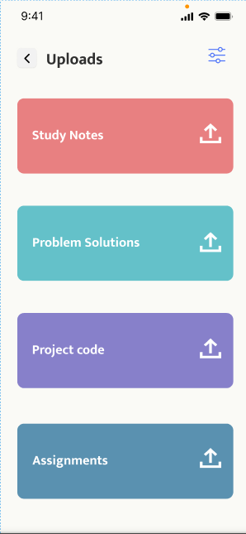
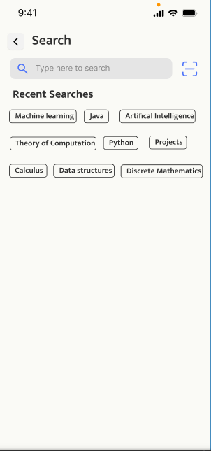
APP PROTOTYPE

Slide 16
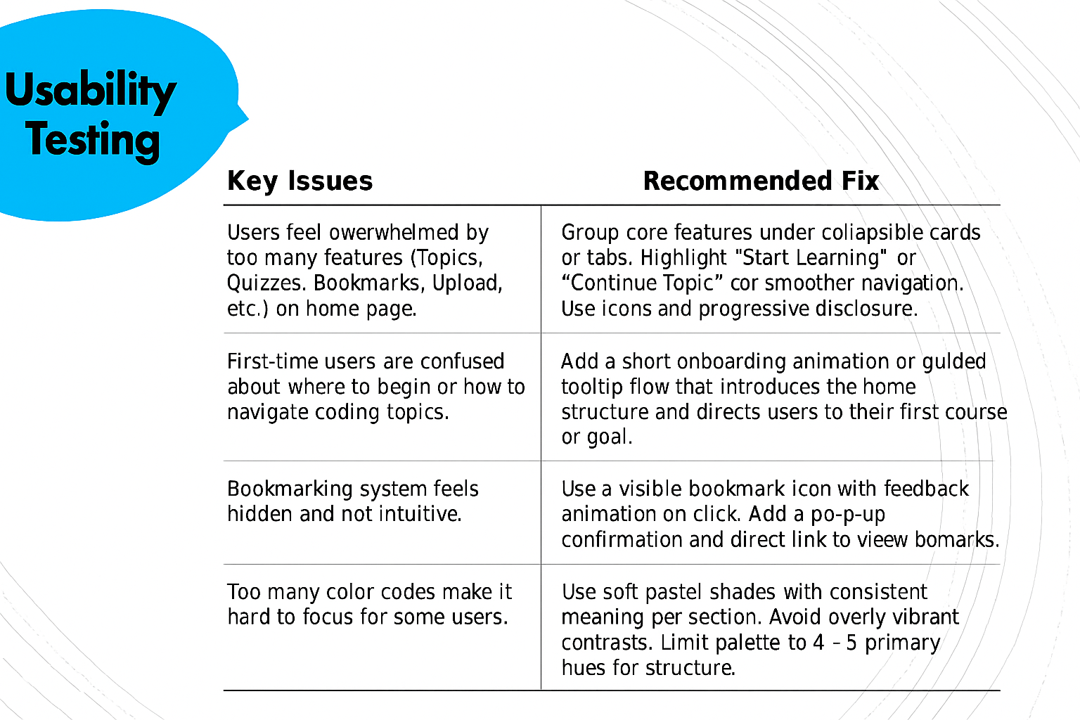
Usability Testing

Slide 17
Thank
you

